Slide 1
Basic Data Analysis
(or as some people like to call it ‘Data Science’…)

Slide 2
What is ‘Data Science’?

Slide 3
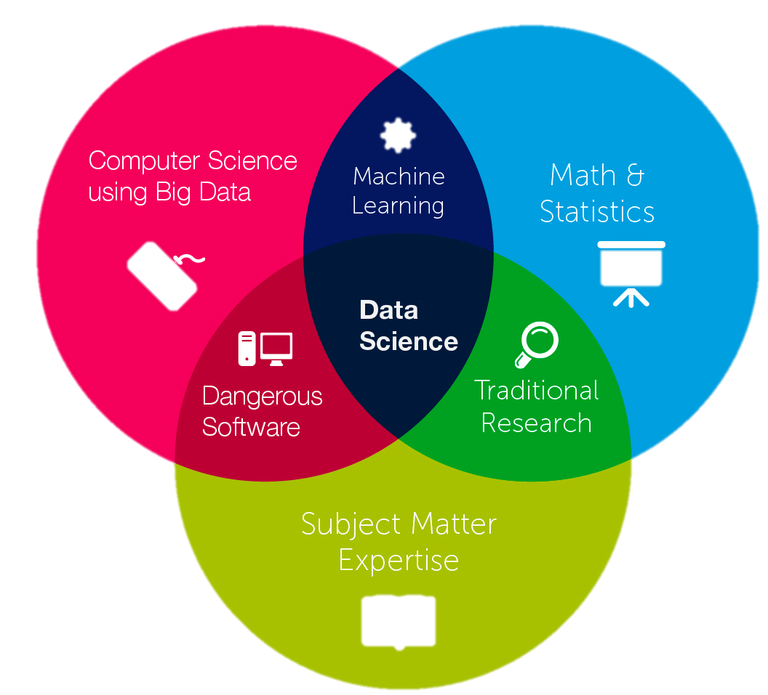
What is ‘Data Science’?

Slide 4
What is ‘Data Science’?
SCIENCE

Slide 5
What is ‘Data Science’?
DATA
SCIENCE

Slide 6
What is ‘Data Science’?
DATA
SCIENCE
DATA SCIENCE!!

Slide 7
What are the typical questions when we get a lot of data?
Are there unknown sample groups defined by the data?
- unsupervised analysis (i.e. hierarchical clustering)
What are the important features that associate with the data pattern ?
feature extraction (i.e. generalized linear regression)
Can the selected features be used in a predictive model ?

Slide 8
Generalized Data Analysis Workflow
When you know very little about the data at hand
Raw feature data
Data Wrangling and Imputation
Data Normalization
Unsupervised clustering
Feature extraction
Predictive Model Construction

Slide 9

The Institute of Health Matrix and Evaluation
http://www.healthdata.org/
Notes:
The Institute for Health Metrics and Evaluation (IHME) is an independent global health research center at the University of Washington. The Global Health Data Exchange (GHDx) is a data catalog created and supported by IHME.

Slide 10
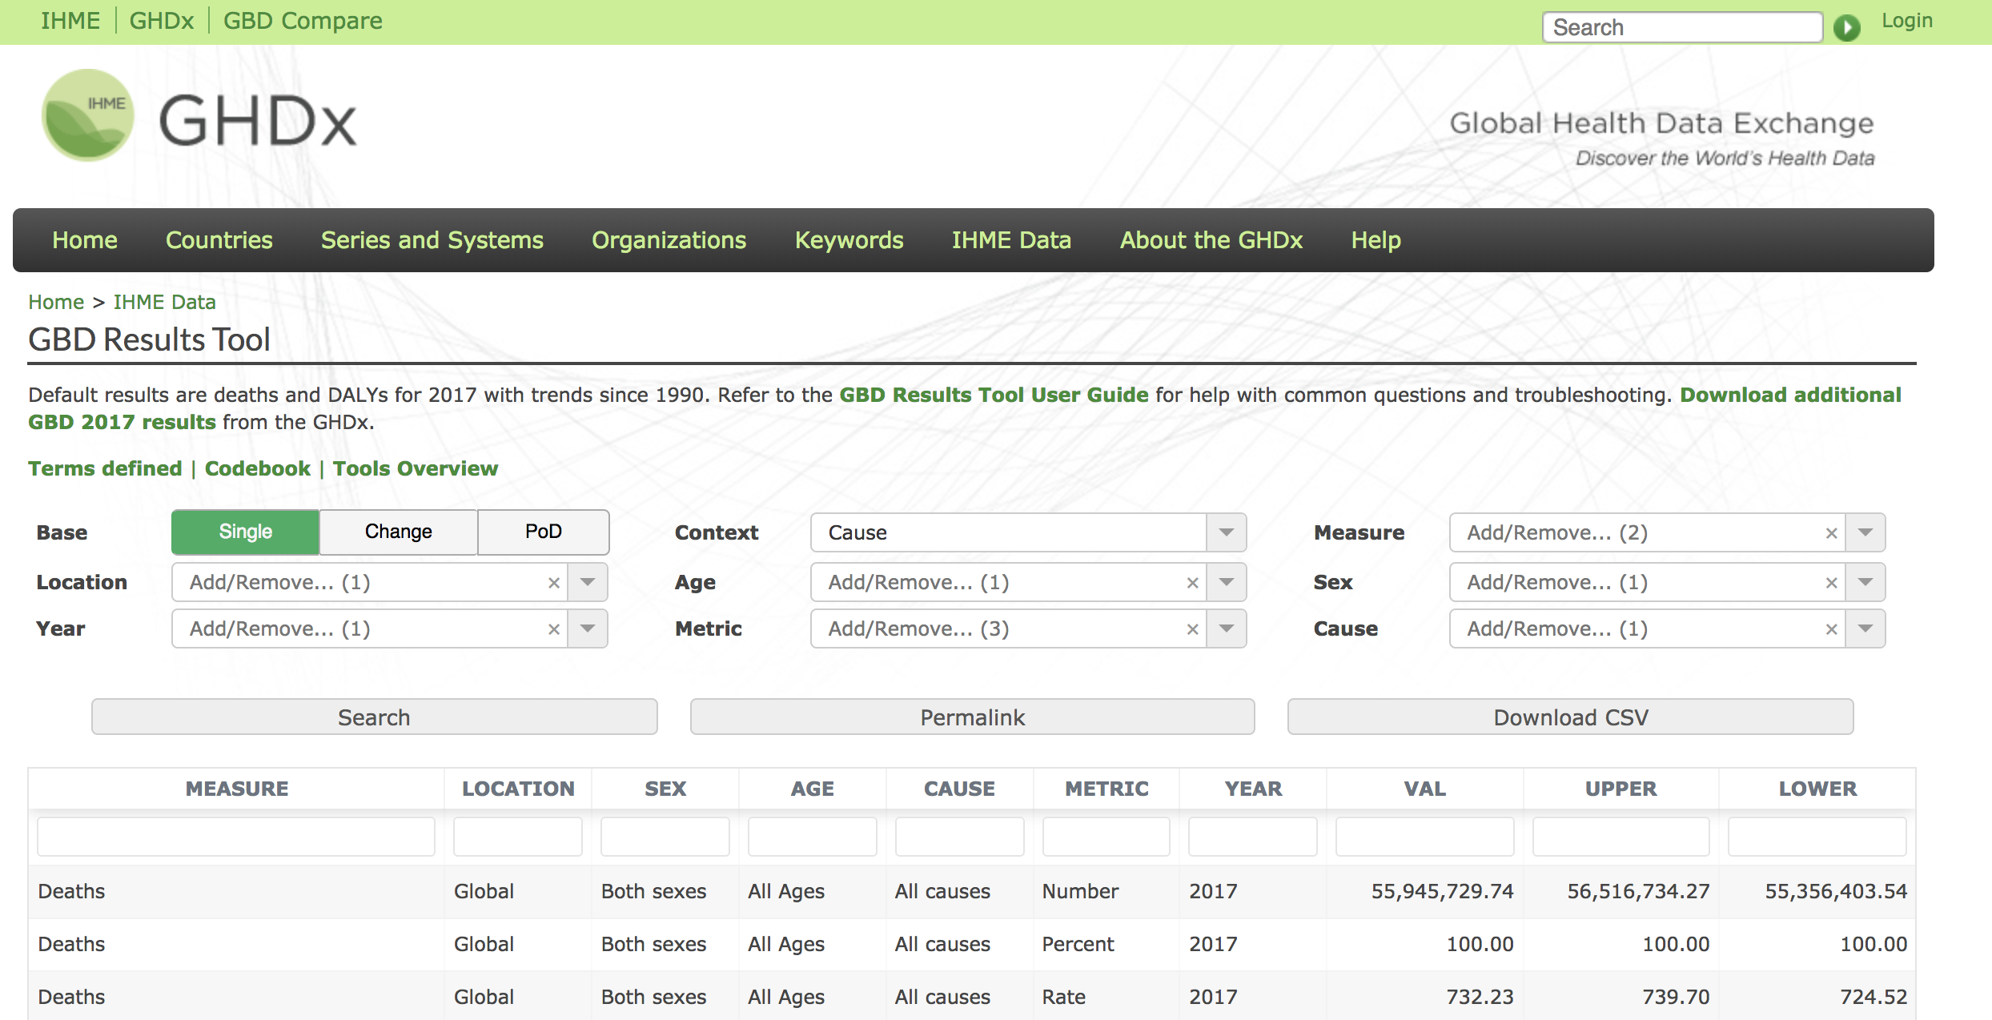
The Global Health Data Exchange (GHDx)
http://ghdx.healthdata.org/gbd-results-tool
Notes:
The Institute for Health Metrics and Evaluation (IHME) is an independent global health research center at the University of Washington. The Global Health Data Exchange (GHDx) is a data catalog created and supported by IHME.

Slide 11
Our Data Set
Downloaded from GHDx
2017 all cause of death data from all countries
195 countries and 133 causes of death
Represented as Percentage of Cause of Death by Country (‘standardization’)

Slide 12
Our Strategy
Load prepared data
raw data downloaded from GHDx was store in data/IHME-GBD_2017_DATA and pre-processed and annotated by data_preprocess.R
Visualize Data distribution
Feature reduction by Principle Component Analysis (PCA)
Project on a Scatter Plot
unsupervised clustering
Perform Hierarchical clustering using Euclidean Distance
Feature Extraction
linear regression to find the most common cause of death globally

Slide 13
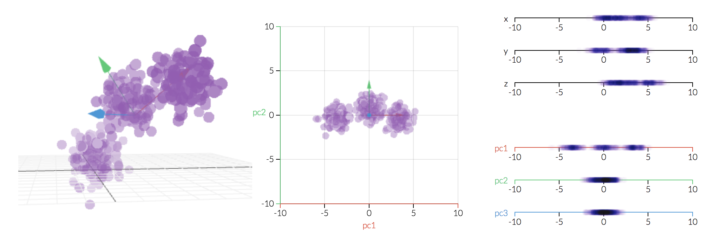
Principle Component Analysis (PCA)
Feature reduction technique that convert a set of observations of possibly correlated variables into a set of linearly uncorrelated variables (Principle Component or PC’s)
3-D
2-D
1-D
http://setosa.io/ev/principal-component-analysis/

Slide 14
Hierarchical Clustering: Dendrogram
Determine pairwise distance between all samples with each sample being its own cluster
Connect closest pair of cluster until there is only one
Cutting the dendrogram at a desired level to obtain desired number of clusters

Slide 15
Hierarchical Clustering: Dendrogram
Determine pairwise distance between all samples with each sample being its own cluster
Connect closest pair of cluster until there is only one
Cutting the dendrogram at a desired level to obtain desired number of clusters

Slide 16
Hierarchical Clustering: Dendrogram
Determine pairwise distance between all samples with each sample being its own cluster
Connect closest pair of cluster until there is only one
Cutting the dendrogram at a desired level to obtain desired number of clusters

